Slide 1
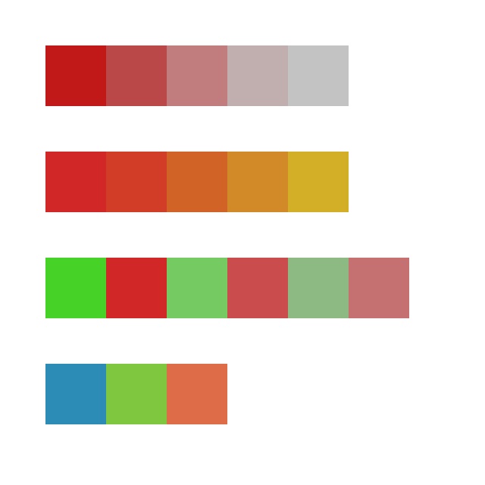
Monochromatic
Analogous
Complementary
Triad

